Slide 1
Reactec Analytics Platform
The future of HAVS Monitoring systems with DROPS risk mitigation inbuilt
Designers and manufacturers of the
HAVWEAR
Notes:
Ensure the presentation and notes content are fully understood
The Value propositions in each slide (complemented with these notes – need to be delivered):
Before presenting
Ask the audience what they do for HAVs just now
If they do actually do something, how do they manage this :
Walk them through there processes and do not be judgmental.
Praise them for doing something and maybe highlight other points that they may want to do that benefits them. Like vibration testing ?
Question how laborious they feel their process is? OR If they don’t really do much highlight how laborious it would be.
How accurate is their process?
How do they store all the data ect ?
This will keep the presentation interactive and make the prospective customer involved in the whole process.

Slide 2
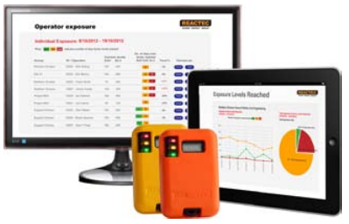
Presentation outline
Overview of Hand Arm Vibration
Meeting HSE legislation
Reduce HAVS risk
Introduction to HAVwear
HAVwear as a DROPs consideration

Slide 3
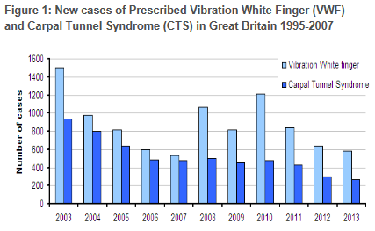
Hand Arm Vibration (Social impact)
2,000,000 people at risk of HAVS*
“All new cases of HAVS will be eliminated by 2015” but HAVS remains a constant risk *.
300,000 suffering advanced stages of HAVS*
3,000 claims each year * *
*HSE ** Industrial Injuries Disability Benefit scheme
Notes:
Key points
10% risk is taken from the HSE inspectors pack – Appendix C of http://www.hse.gov.uk/foi/internalops/fod/inspect/hav.pdf
The other key points are taken from the HSE website - http://www.hse.gov.uk/VIBRATION/hav/keymessages.htm
…………………………………………………………………………………………………………………………………………
BACKGROUND INFORMATION
Vibration white finger (VWF), also known as hand-arm vibration syndrome (HAVS) or dead finger, is a secondary form of Raynaud's syndrome. HAVs is an industrial disease triggered by continuous use of vibrating hand-held machinery. Use of the term "vibration white finger" has generally been superseded in professional usage by broader concept of HAVS, although it is still used by the general public. The symptoms of vibrating white finger are the vascular component of HAVS.
Hand Arm Vibration Syndrome can be contracted within 6 months
Staging
The Stockholm system is used to grade severity:
Sensorineural component
0SN - exposed to vibrations but no symptoms.
1SN - intermittent numbness +/- tingling.
2SN - numbness (intermittent or continuous) with loss of feeling of touch.
3SN - numbness (intermittent or continuous) with loss of discrimination by touch +/- manual dexterity.
Vascular component
Stage 1 - mild, with only occasional attacks affecting the tips of one or more fingers.
Stage 2 - moderate, with occasional attacks affecting the distal or middle phalanges of one or more fingers.
Stage 3 - severe, with frequent attacks affecting all phalanges of most fingers.
Stage 4 - very severe, as Stage 3, plus trophic changes in fingertips.

Slide 4
Hand Arm Vibration (financial impact)
Highest % of disability claims are HAVS related* *
Every £1 recovered through insurance, costs a company £10 in uninsured costs***
60,000
50%
Surge in employee claims*
Increase in successful HAVS claims (2007 – 2013)**
18,000
2008
2013
*HSE **Industrial Injuries Disablement Benefit ** HSE - Fines, legal fees, sick pay, production delays
Notes:
Key points
UK is good on Safety but Health as not had equal investment or focus
HAVS RIDDORS have decreased over time but are still a real issue
Employee litigation has increased
…………………………………………………………………………………………………………………………………………
BACKGROUND INFORMATION
Employee general claims trend - surge in employee claims (DWF). This trend has increased due to noise claims.
2008 18,000 claims – 2013, 60,000 claims

Slide 5
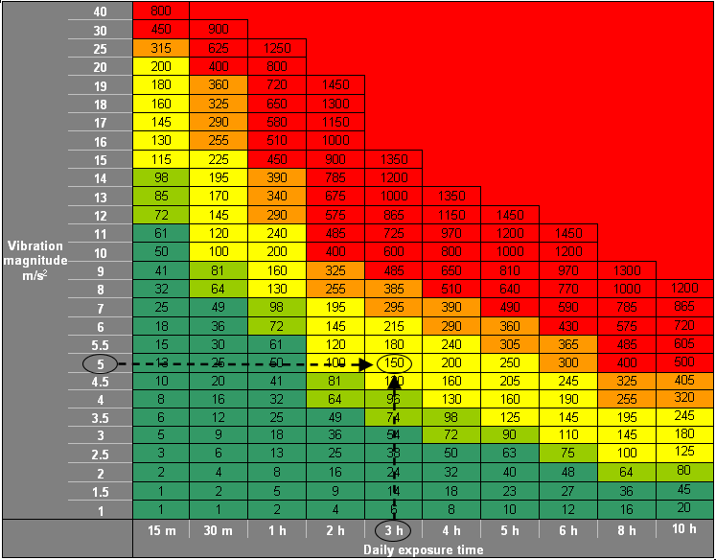
Tool Tags The HSE exposure point system to quantify risk For an accurate estimate of risk - trigger time and the representative vibration magnitude need to be known in any one day.
100 points (8 hrs of a tool with 2.5² m/s² )
EAV
Take action to reduce exposure. 1 in 10 develop HAVS in 12 years at this level.
400 points (8 hrs of a tool with 5² m/s² )
ELV
Do not work above this level. 1 in 10 develop HAVS in 6 years at this level.
Notes:
SUMMARY
How the points system relates to tool vibration magnitude and duration of use.
Below EAV - take actions, which are relatively inexpensive and simple to carry out.
Above EAV - look for alternative processes, equipment and/or working methods which would eliminate or reduce exposure or mean people are exposed for shorter times.
Also be keeping up with what is good practice for vibration control within your industry.
No one should exceed their ELV.

Slide 6
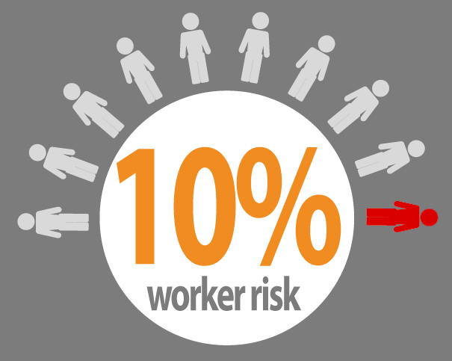
Hand Arm Vibration (HAV)
10% of employees exposed at the exposure action level will contract HAVS within 12 years or within 6 years if exposed to the exposure limit level. (HSE)
“Exposure below the Action Value cannot be considered safe...” (HSE)
Notes:
For those of you unfamiliar with the HSE point system. It is a system to allow you to clock up that is combine the risk associated with the daily use of vibratory system. It is based on daily use and the advise is that if someone uses the equivalent of a drill with 2.5m/s2 magnitude of vibration for 8 hours they would have exposure points of 100. If they used a tool equivalent to a hammer drill on hammer of 5m/s2 for 8 hours they would amass exposure points of 400.
The advise is NOT to work above 400 points per day and if working above 100 points then to put in place controls and demonstrate ongoing reduction of the exposure risk
HOWEVER please note
Headline statistic as provided in the HSE inspector’s guide.
10% of employees exposed at the exposure action level will contract HAVS within 12 years or within 6 years if exposed to the exposure limit level.
“Exposure below the Action Value cannot be considered safe...”
Clicker question #1. Are you aware of this statistic
Clicker question #2. Given this statistic would you set your action value at 50, 75 or 100
…………………………………………………………………………………………………………………………………………

Slide 7
Accuracy of exposure
Digital monitoring addresses many of these issues
Estimating tool use, performance and types of work.
Tool data more
representative
Accurate time on tools with representative tool info
Measurement no longer reliant on tool fixed data.
Complies to ISO5349
Considerations
Factor of 3
Factor of 2
Factor of 0.4
20%
20%
Inaccuracy
Under/Over estimation
 Tool monitoring | Paper based estimation | Paper based estimation | Digital tool monitor | Digital worker monitor | Digital worker monitor
 Worker coverage/ duration | Sample workforce/ time period | Sample workforce/ time period | Total coverage/ Constant | Total coverage/ Constant | Total coverage/ Constant
 HSE points calculation | Based on manufacturers data | Based on ISO5349 Of “typical” work | Based on ISO5349 Of “typical” work | Estimate of ISO5349 in use | Complaint ISO5349 In use
Continuous digital monitoring offers greater protection for employers and employees. FACT
Notes:
So how much better can it be with digital monitoring
Assuming a solid effort to tag tools with a truly Representative vibration level of the work to be undertaken Reactec would suggest that the error will be less than 40%

Slide 8
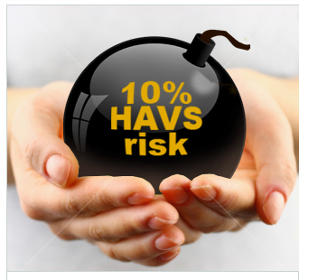
Summary of the Reactec Analytics Platform
Easy, accurate and effective HAVs management.
Compliance to HSE regulations.
Safer working environment for employees.
Defendable processes against personal liability claims.
Notes:
SUMMARY
Summary of last three slides as the three key benefits of Reactec Analytics Platform.

Slide 9
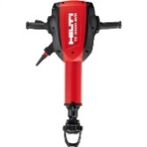
Accuracy of exposure
Tool magnitude variation
FACT: Tool vibration varies due to work types.
The graph displays the average vibration of tools over 18 months. All tools are either below or above the predefined exposure magnitude.
5m/s² variation equals on 5m/s² yields 200 points per hour rather than 50 points per hour
10m/s² variation yields on 5m/s² 450 points per hour rather than 50 points per hour
FACT: Tool vibration exposure varies per user.
Tool magnitude
Over 2 years, the average vibration per operator ranges from 3.3m/s² to 19.1m/s².
1h trigger time at 7m/s² = 98 points
1h trigger time at 19.1m/s² = 730 points
20 m/s²
15 m/s²
10 m/s²
5 m/s²
3 m/s²
Hilti TE3000 breaker programmed at 7m/s²
Operator1
Operator2
Operator3
Operator4
Notes:
To illustrate this in a more direct way
We have looked at one particular tools use within a single customer, looking at the identical tool’s use over 4 different operators and graphed as a % difference to the programmed level of 21m/s/s
Operators 4 uses the tool quite differently to Operator 2.
Relative to the reported exposure of 370 points for 25 mins work, The HAVmeter would suggest he would receive 1,470 points.
Remember the exposure points are proportional to the square of the vibration level. So even small errors are significant

Slide 10
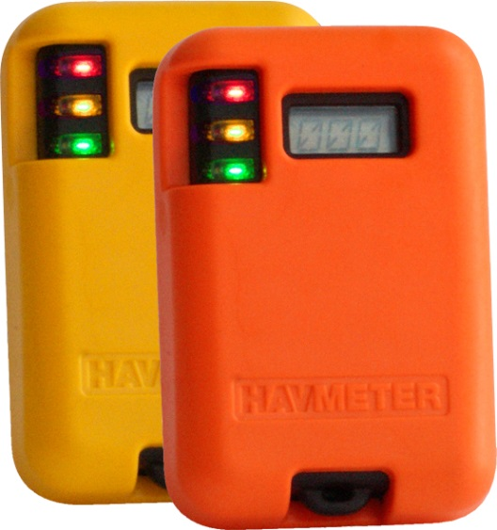
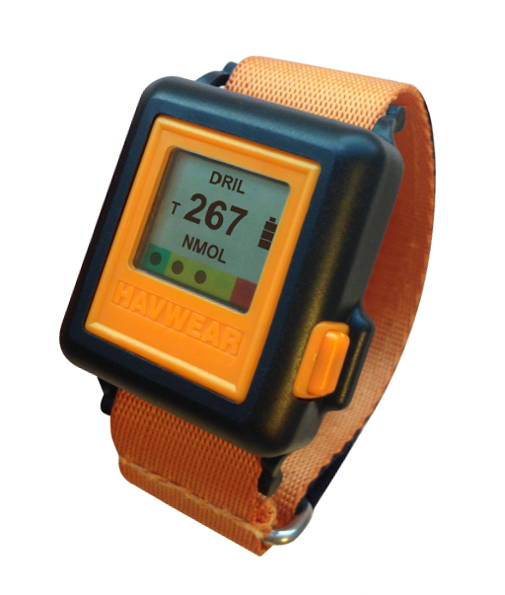
Reactec monitoring devices
HAVMETER
HAVWEAR
Notes:
SUMMARY
…………………………………………………………………………………………………………………………………………
BACKGROUND INFORMATION
The work flow for using the HAVmeter systems starts with;
An operator “swiping” out a HAVmeter. This personalises the HAVmeter to the operator and provides the HAVmeter with information on the operator identity and their individual Exposure values. Operators with early stages of HAVs can have lower action and limit values to allow them to continue to work but at lower levels.
The operator picks up the HAVmeter and uses it on all tagged tools within their working day.
By RFID technology the HAVmeter picks up the tool identity to combine with the operator identity.
Within the HAVmeter the HSE methodology is applied to calculate the operators cumulating exposure points.
Three LED lights are used to give instant visual warnings to the employee and anyone within sight of them that they are
Under their EAV level - GREEN
Have exceeded their EAV level – AMBER
Have reached their ELV level – RED and must stop
In support of employee self management of exposure levels – tool tags vary in colour. Enables the operator to move to a lower vibration tool if they are clocking up too many points
Green = <2.5m/s² Note : at 2.5 max continual use = 8 hours to reach Action value
Amber = 2.5 <> 5m/^{s} Note at 5.0 max continual use = 2 hours to reach Action value
Red = >5m/^{s}
At the end of the day the operator returns the HAVmeter to the Basestation. On docking, the HAVmeter downloads the data within the HAVmeter of all the employees exposure details since undocking, into an internal memory in the Basestation. From this point on all data collection and management is fully automated

Slide 11
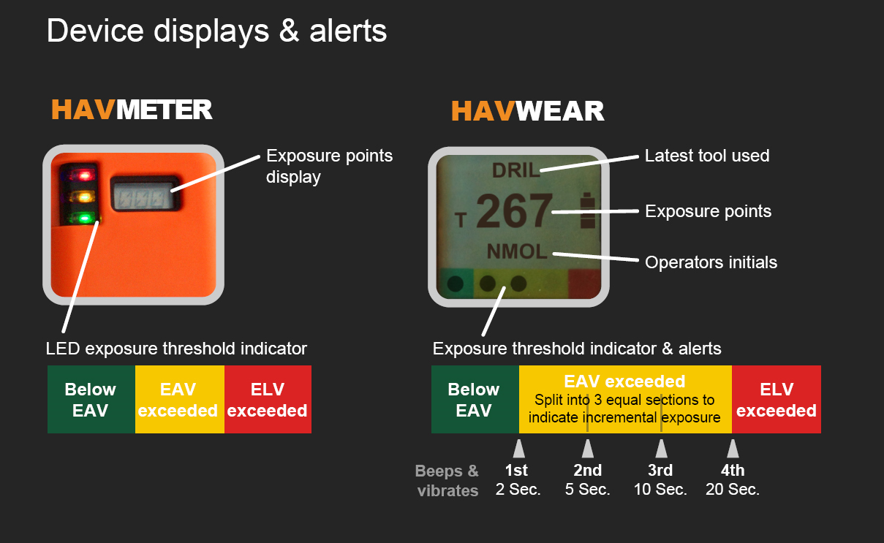
How it works
Notes:
SUMMARY
…………………………………………………………………………………………………………………………………………
BACKGROUND INFORMATION
The work flow for using the HAVmeter systems starts with;
An operator “swiping” out a HAVmeter. This personalises the HAVmeter to the operator and provides the HAVmeter with information on the operator identity and their individual Exposure values. Operators with early stages of HAVs can have lower action and limit values to allow them to continue to work but at lower levels.
The operator picks up the HAVmeter and uses it on all tagged tools within their working day.
By RFID technology the HAVmeter picks up the tool identity to combine with the operator identity.
Within the HAVmeter the HSE methodology is applied to calculate the operators cumulating exposure points.
Three LED lights are used to give instant visual warnings to the employee and anyone within sight of them that they are
Under their EAV level - GREEN
Have exceeded their EAV level – AMBER
Have reached their ELV level – RED and must stop
In support of employee self management of exposure levels – tool tags vary in colour. Enables the operator to move to a lower vibration tool if they are clocking up too many points
Green = <2.5m/s² Note : at 2.5 max continual use = 8 hours to reach Action value
Amber = 2.5 <> 5m/^{s} Note at 5.0 max continual use = 2 hours to reach Action value
Red = >5m/^{s}
At the end of the day the operator returns the HAVmeter to the Basestation. On docking, the HAVmeter downloads the data within the HAVmeter of all the employees exposure details since undocking, into an internal memory in the Basestation. From this point on all data collection and management is fully automated

Slide 12
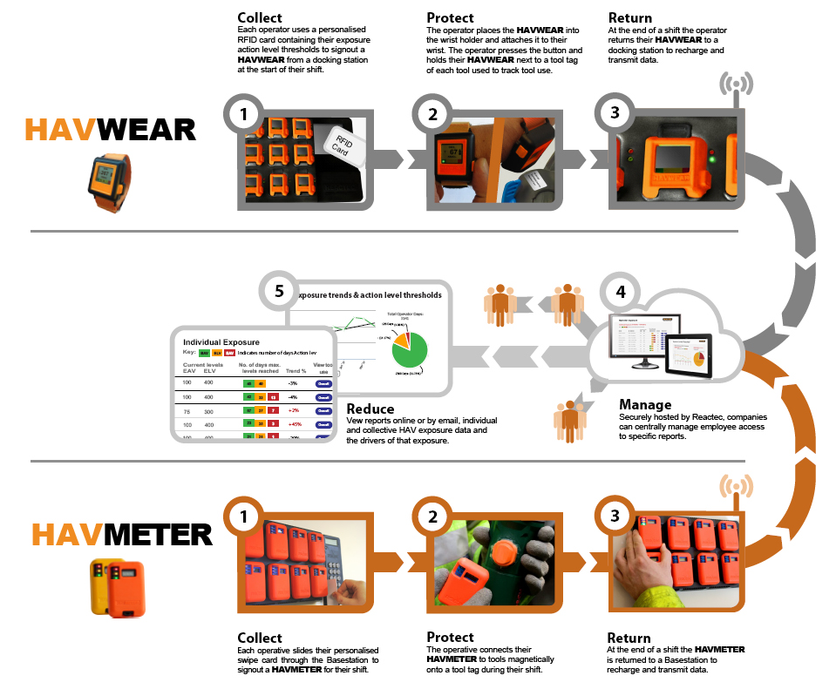
How it works
Notes:
SUMMARY
…………………………………………………………………………………………………………………………………………
BACKGROUND INFORMATION
The work flow for using the HAVmeter systems starts with;
An operator “swiping” out a HAVmeter. This personalises the HAVmeter to the operator and provides the HAVmeter with information on the operator identity and their individual Exposure values. Operators with early stages of HAVs can have lower action and limit values to allow them to continue to work but at lower levels.
The operator picks up the HAVmeter and uses it on all tagged tools within their working day.
By RFID technology the HAVmeter picks up the tool identity to combine with the operator identity.
Within the HAVmeter the HSE methodology is applied to calculate the operators cumulating exposure points.
Three LED lights are used to give instant visual warnings to the employee and anyone within sight of them that they are
Under their EAV level - GREEN
Have exceeded their EAV level – AMBER
Have reached their ELV level – RED and must stop
In support of employee self management of exposure levels – tool tags vary in colour. Enables the operator to move to a lower vibration tool if they are clocking up too many points
Green = <2.5m/s² Note : at 2.5 max continual use = 8 hours to reach Action value
Amber = 2.5 <> 5m/^{s} Note at 5.0 max continual use = 2 hours to reach Action value
Red = >5m/^{s}
At the end of the day the operator returns the HAVmeter to the Basestation. On docking, the HAVmeter downloads the data within the HAVmeter of all the employees exposure details since undocking, into an internal memory in the Basestation. From this point on all data collection and management is fully automated

Slide 13
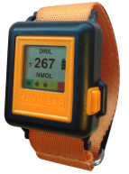
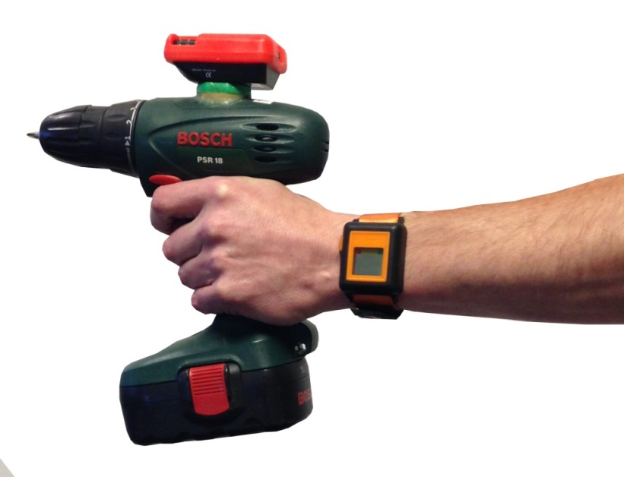
HAVWEAR
Personal HAVS Protection
The science behind the HAVWEAR
The HAVWEAR incorporates a precision triaxial accelerometer to;
Accurately determine trigger use through intelligent filters to distinguish tool use from other movements.
To measure the sensed vibration on 3 axis based on sampling every second for 1/3 sec.
The only product on the market;
Not required to be physically attached to the tool
Senses through the wrist the impact to the individuals hand by way of bespoke algorithms

Slide 14
HAVWEAR
Personal HAVS Protection
Intrinsic Drops Risk Mitigation
The HAVmeter could be knocked off a tool.
Current corrective action – tether the HAVmeter to the tool with a lanyard.
The HAVwear eliminates the drop risk of a monitor from a tool.
Only HAVs risk monitor to not require a monitor mounted to the tool.
?
Does the HAVwear represent a snagging risk?
Is an ATEX HAVwear required by oil & gas?

Slide 15
Inform, protect and deploy resources and assets to further reduce HAV risk.
Contact our customer service team with any further questions
Tel: + 44 (0)131 221 0930
Email: Info@reactec.com
Web: www.reactec.com
Notes:
A reminder of the points covered
HAVs is the fastest growing reported occupational health issue in the UK
There is no cure for HAVs
The HSE have devised a points system which requires businesses to know whether operators are exposed to > 2.5m/s² for >8 hours
An employees susceptibility to HAVs increases exponentially with vibration level and the external conditions such as coldness
Reactec’s analytic platform incorporating the HAVmeter is the most accurate and automated system in the market which gives real business intelligence collating workers exposures, tool use and employee deployment

Slide 16
First Integrated Solutions is the preferred local distributor for REACTEC HAVMETER and HAVWEAR
To discuss the HAVMETER and HAVWEAR system or if you have any questions regarding your vibration management requirements, please contact us:
TEL: +44 (0) 01224 707585
EMAIL: sales@firstintegrated.co.uk
WEB: www.firstintegrated.co.uk

