Slide 1
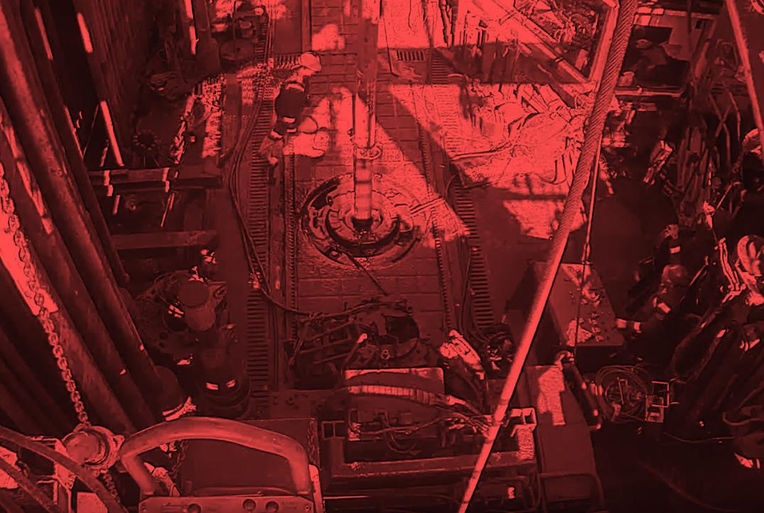

Learning from Incidents
HiPo Incident - Overdrive Mud Saver Dropped during 7-5/8” Liner Running Operation
Published by DROPS (Dropped Object Prevention Scheme) MAY 2026

Slide 2
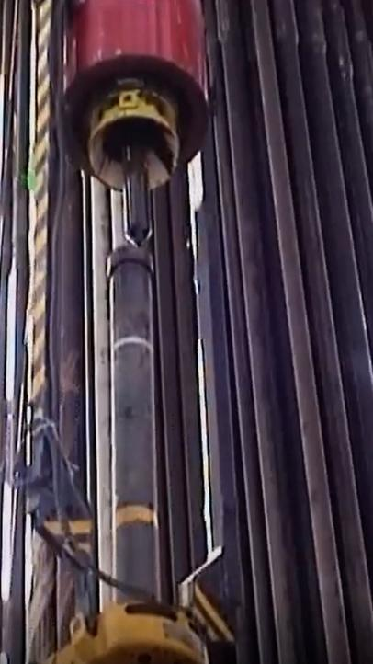
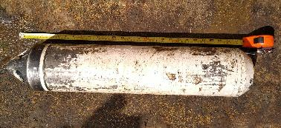
Incident Summary
OVERDRIVE
During liner running operations involving the 7-5/8” liner, the Overdrive Mud Saver was being lowered onto a stationary liner joint held in single joint elevator.
While running down the Overdrive, the tip of the Mud Saver contacted the rim of the Liner, resulting in the Mud Saver disconnecting from its mandrel.
The Mud Saver dropped from height of approximately 14 meters, struck a belt tong and deflected 2m across the rig floor.
There was no harm to personnel, and the well integrity was not compromised.
MUD SAVER
CONTACT
7 5/8” LINER
Classification: HiPo Near Miss
Height: 14 meters
Weight: ~40 kg
Fall Energy: 5.5kJ
MUD SAVER (Length 70cm)
ELEVATOR
LEARNING FROM INCIDENTS

Slide 3
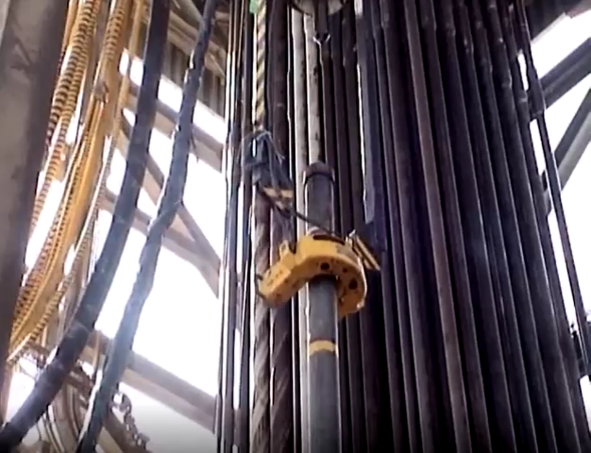
CCTV FOOTAGE

Slide 4
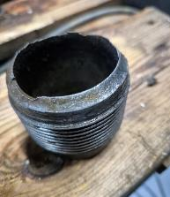
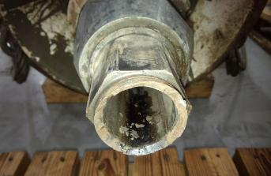
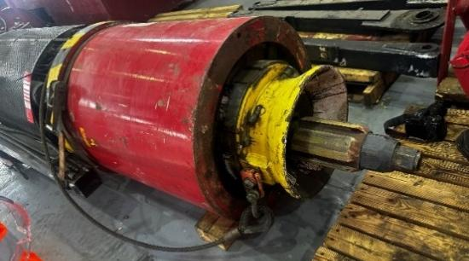
Immediate Actions
Further DROPS checks confirmed no other issues.
Relevant Equipment checks completed.
3rd Party representative was involved to confirm the equipment condition.
Safety Standdown initiated:
Incident details (photos, video, description) were shared with all personnel; including 3rd Party, focusing on Red Zone management, complacency, and overconfidence.
Red Zone Drills for mandatory two-way access and exit visual communication initiated on the rig.
The requirement was communicated during all pre-mobilisation meetings and TBTs.
Follow up visit to Vendor location / Tool Inspection.
BROKEN MANDREL (Safety factor in failure scenario is calculation to be well above the 4.2 tonnes load applied – should have withstood the impact)
EXTERNAL OVERDRIVE
LEARNING FROM INCIDENTS

Slide 5
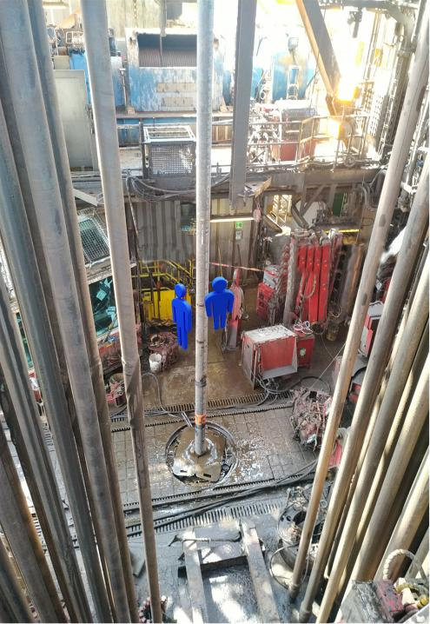
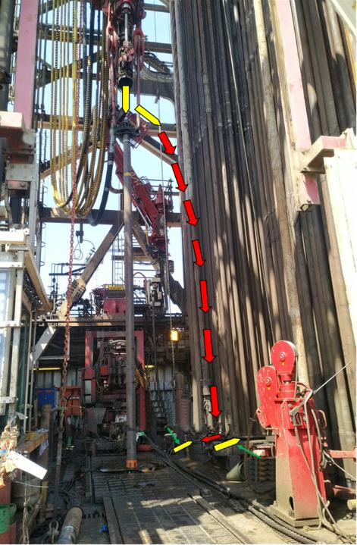
Personnel
Exposure
MUD SAVER
Location of Personnel as Mud Saver impacts drill floor.
3rd PTY TECH
FLOOR HAND
DEFLECTS 2m
IMPACT POINT

Slide 6
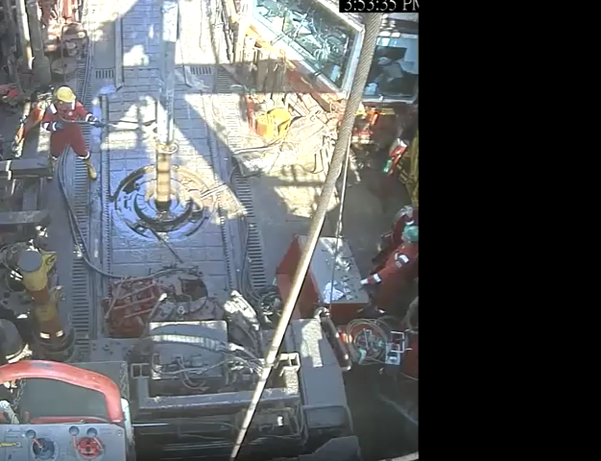
CCTV FOOTAGE (Split view / Simultaneous)
Drill Floor Camera
Derrick Camera / Drillers View

Slide 7
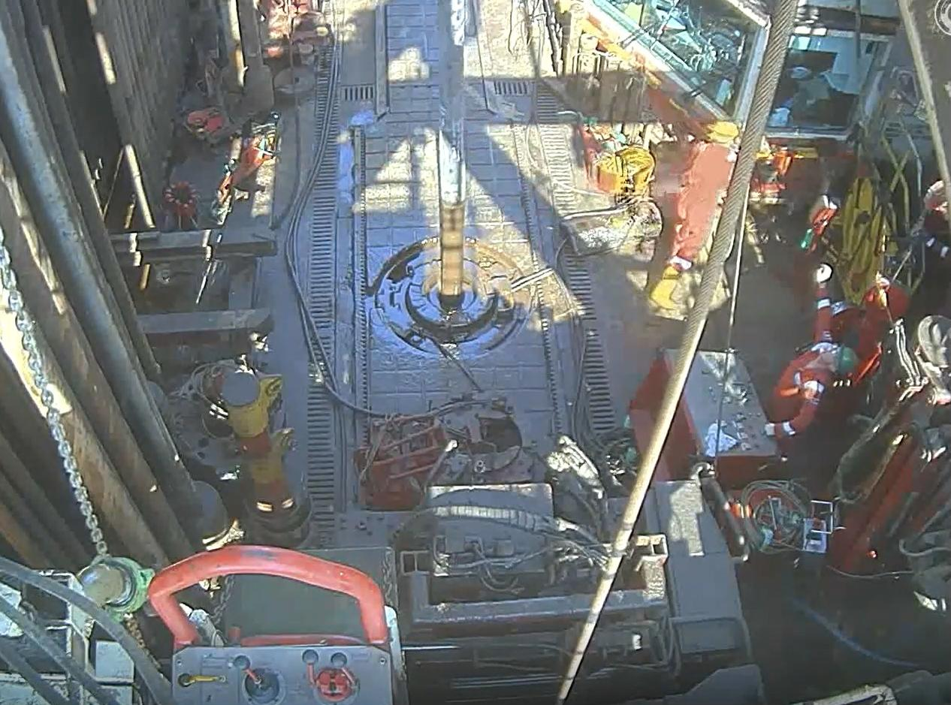
Causes and Recommendations
DRILLER’S CAB
A number of Immediate Causes were identified, with particular reference to Red Zone Management.
Root Causes addressed further issues including Human Performance factors that created error traps. The following slides illustrate these.
NOTE: The image on the right shows the exact position of personnel exposed in the Red Zone as the Mud Saver makes contact with the Liner.
FLOOR HAND
Has retrieved the stubbing guide and is placing it on storage rack at Drillers Cabin window.
CONTROL UNIT
3rd PARTY TECHNICIAN / CU Operator
Is looking up as contact is made with the liner.
Attempting to communicate with Driller using confused hand signals.
LEARNING FROM INCIDENTS

Slide 8
Causes and Recommendations SYSTEM & ADMINISTRATIVE CONTROLS
IMMEDIATE CAUSE: Operating at Improper Speed. Although in Gear 1, the Driller failed to reduce the speed while stabbing the overdrive into the liner joint
ROOT CAUSE – Job / System Factors
RECOMMENDATIONS
The 'Making Up Casing' guideline instructs to "Lower DDM but slow down. Stab Mud Saver Valve into box," but it does not define a specific speed limit or operational mode.
The Work Instruction in use lacks guidance on speed or mode for stabbing the Mud Saver Valve.
Update guideline and Work Instruction to specify ‘Creep Mode’ for DDM during making up casing / liner with the Overdrive.
Communicate change to all personnel.
Conduct gap analysis on other operations with similar risk to specify ‘Creep Mode’ or specific speed limit.
HPF
Key hazards (stabbing speed, misalignment, proximity, impact potential) were not explicitly addressed in work instructions. The lengthy, generic operating guidelines created cognitive overload, leading to task-focused deviation and unclear risk awareness.
HUMAN PERFORMANCE FACTORS
LEARNING FROM INCIDENTS

Slide 9
Causes and Recommendations SYSTEM & ADMINISTRATIVE CONTROLS
IMMEDIATE CAUSE: Improper Equipment Placement. Misalignment of liner and mud saver while stabbing the overdrive.
ROOT CAUSE – Job / System Factors
RECOMMENDATIONS
The camera system installed to assist the driller in monitoring connection height was found to be insufficient, limiting visual clarity and affecting driller’s ability to accurately assess alignment.
Add a new or upgrade / adjust the existing camera system to obtain the position for clear, unobstructed views of the connection interface.
Conduct a survey during next casing / liner running operation using existing cameras to confirm capabilities.
HPF
Limited situational awareness and impaired decision-making due to insufficient camera visibility of the connection interface.
HUMAN PERFORMANCE FACTORS
LEARNING FROM INCIDENTS

Slide 10
Causes and Recommendations SYSTEM & ADMINISTRATIVE CONTROLS
IMMEDIATE CAUSE: Failure to inform / warn. Previous incident learnings were not revisited or addressed prior to operation.
ROOT CAUSE – Job / System Factors
RECOMMENDATIONS
A bent mandrel incident occurred 8 years prior while running a 7 5/8" liner on another rig. Following the event, miscommunication led to incorrect assumptions regarding the use of the overdrive system for this liner size.
As a result, corrective actions from previous similar incidents were not embedded into operational practices. This exposed gaps in the Lessons Learned system.
Conduct a gap analysis and enhance the Lessons Learned process by implementing a centralized, structured, and trackable system.
Integrate measurable KPIs to monitor system adoption, procedural alignment, and reduction of repeat events.
HPF
Previous incident learnings not revisited - Memory gap, lessons not embedded.
HUMAN PERFORMANCE FACTORS
LEARNING FROM INCIDENTS

Slide 11
Causes and Recommendations SYSTEM & ADMINISTRATIVE CONTROLS
IMMEDIATE CAUSE: Failure to Follow Procedure / Instruction. The Driller failed to ensure people were out of the red zone before moving the equipment.
ROOT CAUSE – Job / System Factors
RECOMMENDATIONS
Red Zone (RZ) management procedure outlines protocols for controlled entry but lacks a mandatory two-way communication step to confirm exit prior to equipment movement.
Revise Red Zone Management Procedure to include Red Zone matrix, mandate standardized two-way communication for entry and exit,
Conduct refresher sessions and drills for all personnel on these protocols
Drill Crew to use radio communication as primary method of communication to support entry / exit confirmation. and send feedback to management team on the outcome to follow up.
Include adherence checks in routine self-verification audits.
HPF
Task fixation and reliance on hand signals over radios reduced focus on monitoring people in the red zone.
HUMAN PERFORMANCE FACTORS
LEARNING FROM INCIDENTS

Slide 12
Causes and Recommendations SYSTEM & ADMINISTRATIVE CONTROLS
IMMEDIATE CAUSE: Failure to Follow Procedure / Instruction. The Driller failed to ensure people were out of the red zone before moving the equipment.
ADDITIONAL FINDINGS
RECOMMENDATIONS
Dynamic Red Zone Management System did not trigger an alarm because the allowable number of people in the zone was not exceeded.
The dynamic reset feature that would trigger the alarm by resetting the number to 0 due to equipment movement had not been integrated with the drilling equipment.
Note: Red Zone Management technology was not reliable at the time of the incident due to concerns from previously reported false detections.
Implement OEM integration to achieve Dynamic Red Zone system.
LEARNING FROM INCIDENTS

Slide 13
Causes and Recommendations SYSTEM & ADMINISTRATIVE CONTROLS
IMMEDIATE CAUSE: Failure to Follow Procedure / Instruction. 3rd Party Technician / Control Unit Operator was in the Red Zone during the Mud Saver Valve stabbing.
ROOT CAUSE – Job / System Factors
RECOMMENDATIONS
The 3rd Party Technician / Control Unit Operator attempted to assist the Driller using hand signals while MSV was being stabbed into box, despite no procedural requirement.
He lacked clarity regarding procedural expectations leading to confusion.
Update Operational Guidelines to specify operational stages requiring Control Unit Operator involvement.
Clarify roles and responsibilities and communicate this to relevant personnel.
HPF
Lack of clear procedural guidance and role clarity led to confusion, stress and miscommunication.
HUMAN PERFORMANCE FACTORS
LEARNING FROM INCIDENTS

Slide 14
Causes and Recommendations SYSTEM & ADMINISTRATIVE CONTROLS
IMMEDIATE CAUSE: Improper Position for Task. Both the Floor Hand and the 3rd Party Technician / Control Unit Operator were exposed in the Red Zone during the Mud Saver Valve stabbing.
ROOT CAUSE – Job / System Factors
RECOMMENDATIONS
The 3rd Party Control Unit was positioned in the Red Zone as per standard rig up design, with no remote-control option or protective structure.
Evaluate potential relocation of the control unit outside the Red Zone.
Deliver a final report with an action plan, ensuring safe operation execution without restriction.
Assess remote-control options with 3rd Party.
HPF
Exposure to line of fire due to equipment location, and reliance on human presence instead of engineering solutions, compounded by incomplete rig-up handover.
HUMAN PERFORMANCE FACTORS
LEARNING FROM INCIDENTS

Slide 15
Causes and Recommendations SYSTEM & ADMINISTRATIVE CONTROLS
IMMEDIATE CAUSE: Improper Position for Task. Both the Floor Hand and the 3rd Party Technician / Control Unit Operator were exposed in the Red Zone during the Mud Saver Valve stabbing.
ROOT CAUSE – Job / System Factors
RECOMMENDATIONS
The Floor Hand enters the red zone on several occasions to:
Manually stab the guide with 7-5/8” liner size stabbing guide. Automatic guide only compatible with 9-5/8” and 13-3/8” casing / liner sizes.
Install / remove lifting nubbin on flush connections (shoulder connection single joint type elevator being used). No available single joint slip type elevator.
Trial Volant / VERO to enable Eagle Light to pick up casing / liner - introducing full automation of the operation, eliminating the control panel and removing personnel from the Red Zone.
If this option is not feasible:
Manufacture or upgrade automated stabbing guides to accommodate smaller 7-5/8 liner / casing sizes.
Trial Remote Operated Flush Single Joint Elevator instead of the currently used Remote Operated Single Joint Elevator for lifting nubbin elimination.
HPF
Exposure to line of fire due to equipment location, and reliance on human presence instead of engineering solutions, compounded by incomplete rig-up handover.
HUMAN PERFORMANCE FACTORS

Slide 16
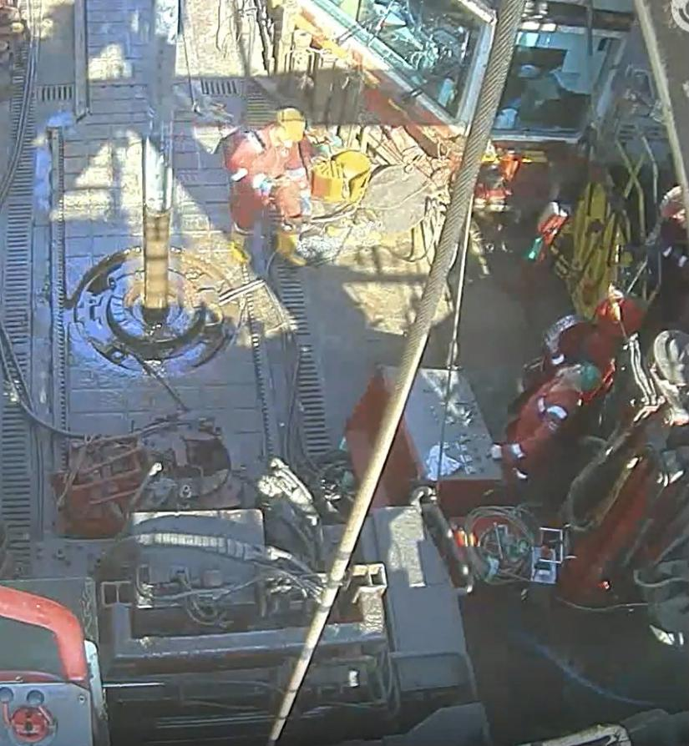
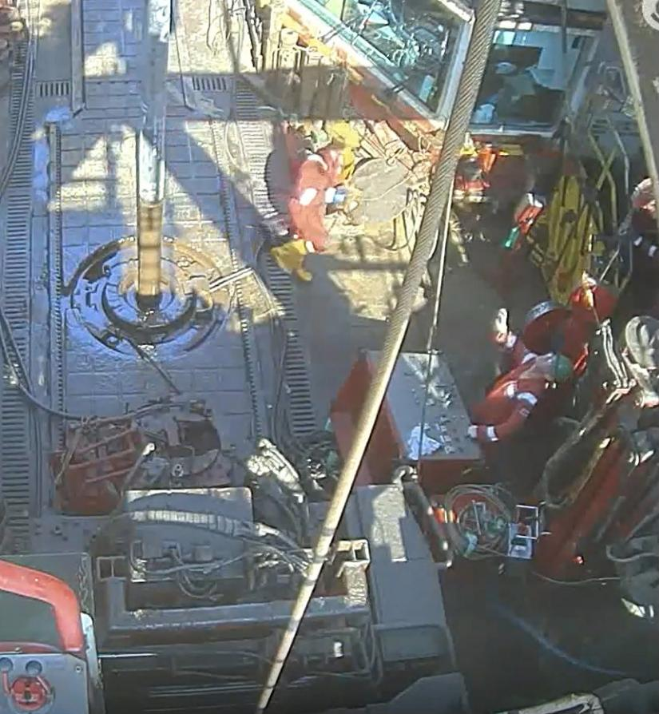


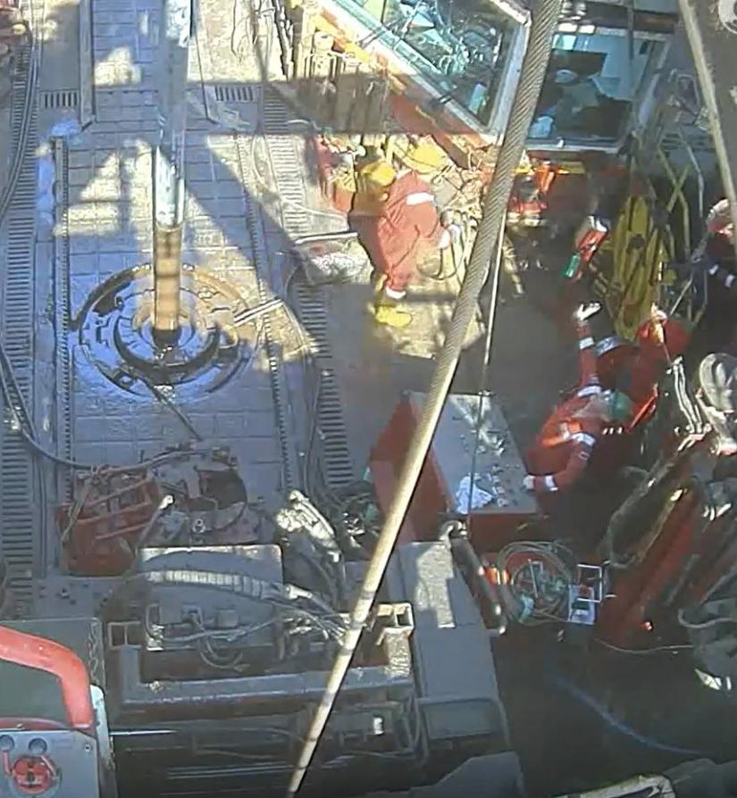
What observations did you have?
Is a ‘fast exit’ ever possible?
Working environment hazards (Slips, trips, falls, sunlight / glare, noise)
Manual Handling / exertion
Is there another person exposed?
What have you learned that will improve your risk assessment for activities in the Red Zone?
LEARNING FROM INCIDENTS

Slide 17
Thank You
For more information please contact admin@dropsonline.org
Published by DROPS (Dropped Object Prevention Scheme) MAY 2026

